Slide 1

BTP- Presentation
Exploring Safety issues in Manufacturing Industry
Presented By:
Aman Agarwal - 20ume006
Ganesh Agarwal - 20ume017
Avish Vijay - 20ucs044
Under Guidance of
Dr. Vikram Sharma
1

Slide 2
S.No. | Topic | Page No.
1. | Literature Review | 3-4
2. | Nomenclature | 5
3. | Why is Industrial Safety Important? | 6
4. | Major Industrial Accidents | 7
5. | Yash Industries | 8-9
6. | Barriers | 10
7. | Enablers | 11
8. | ISM methodology and model development | 12-13
9. | Applying ISM on identified Barriers | 14-18
10 | Applying ISM on identified Enablers | 19-23
11. | Future Work | 24
12. | Conclusion | 25
12. | Bibliography | 26
13. | Thank You | 27
Index
2

Slide 3
Literature Review
S.No. | Researchers | Conclusion / Description
1. | Sharma, V et al.(2015) | An interpretive hierarchical model for lean implementation in machine tool sector
2. | Karen A. Brown et al (2000) | The study emphasizes the importance of industrial safety issues. The research stresses the importance of adopting a systems perspective and conducting further studies to gain a deeper understanding of safety in manufacturing settings.
3. | Preston (2012), Eijk (2015) | One of the barriers to coordination in industrial symbiosis is the need for multiple companies to adjust their daily operations, which can lead to large transaction costs and delays in negotiations. Another challenge is the exchange of information required to understand material and energy flows, which can be both costly and difficult to obtain.
4. | Torstensson (2016) | One of the obstacles in implementing industrial symbiosis is the difficulty in tracking the usage of materials and ensuring the quality of recycled materials. This process can be costly and requires careful monitoring to ensure proper handling.
5. | Liu and Bai (2014) | The implementation of circular economy strategies may be constrained by organizational hierarchies, which can restrict innovation and flexibility. Moreover, the development and execution of these strategies may also be influenced by limitations posed by managers' employment term restrictions.
3

Slide 4
6. | Bjoern Jaeger and Bjoern Jaeger(2019) | Discusses about the barriers faced by circular economy: cases from manufacturing industry
7. | Chinda, T.( 2012) | A safety assessment approach is developed by using results and enablers
8. | Unnikrishnan et al(2015) | Discusses about the safety and management practices in SMEs in India
9. | Griffin, M.A. and Neal, A. (2000) | Discuss about perceptions of safety at work
10. | Urlainis, A et al( 2014) | Discuss impact of natural and man made disaster on industrial infrastructure.
11. | Botzen et al(2019) | Discusses economical impact of natural disasters
12. | Thomas et al (2021) | Discusses effect of man-made disaster on supply chain
13. | Munim et al (2015) | Discusses effect of man-made disaster on commercial logistics
14. | Hasan et al (2022) | Effect of covid on demand and supply chain
15. | Berry et al (2007) | Discusses about the importance of SMEs in economy
16. | Hou et al (2021) | Ensuring worker well-being and preventing accidents in industries requires the establishment of health safety policies and the promotion of a safety culture. The significance of prioritizing industrial safety is highlighted as a critical factor for sustainable growth and development.
17. | Unnikrishnan et al(2015) | Discusses about the industrial safety measurement adopted by SMEs in India
4

Slide 5
Nomenclature
V for i will influence j.
A for i will be influenced by j.
X for factors i and j will influence each other.
O for factors i and j are unrelated to each other.
B1= Technical errors
B2= Errors in the design of facilities or building
B3= Legal and regulatory Barriers
B4= Financial Issues
E1= Leadership
E2= Policy and Strategy
E3= Risk Management
E4= Collaboration for Technology and Digitization
E5= Quality Control
E6= Agile and flexible manufacturing
5

Slide 6


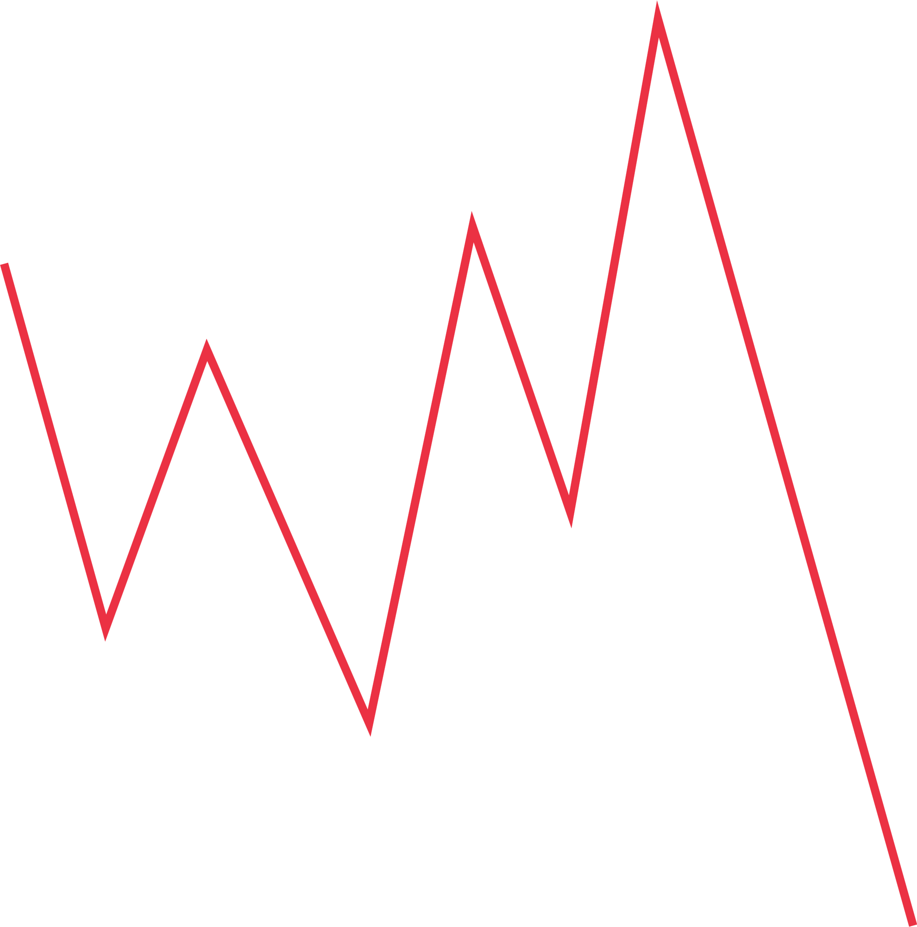



Why is Industrial safety important?
Injury
Financial Loss
Improved Quality
Death
Workers Productiivity
Property Damage
6
Source: Ref15

Slide 7
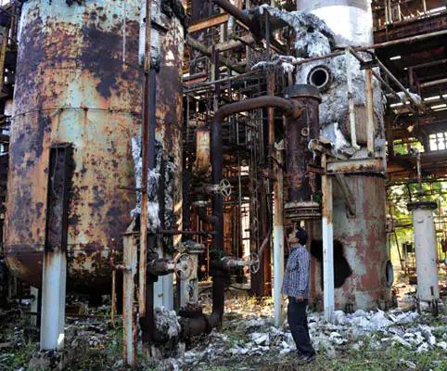

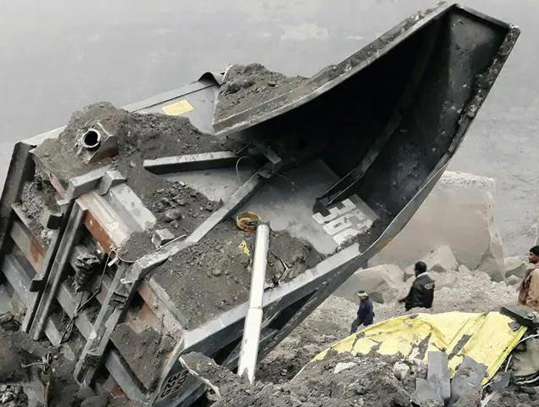
Major Industrial Accidents in India
Bhopal gas tragedy
Korba chimney collapse
Chasnala mining disaster
7

Slide 8
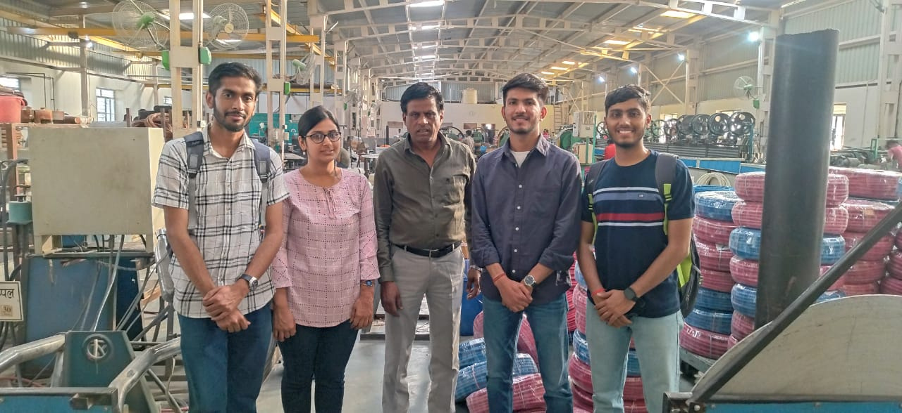
Yash Industries
8
Website Link: https://www.indiamart.com/yash-industriesajmer/profile.html

Slide 9
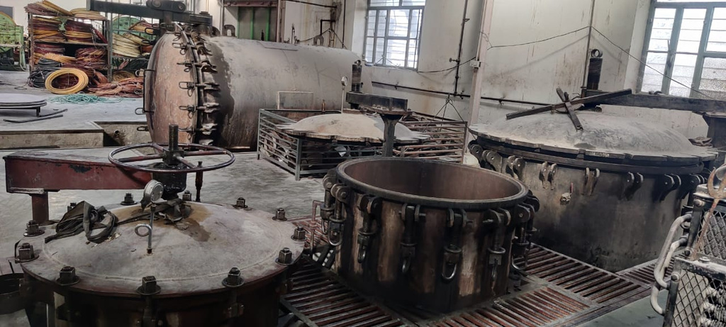
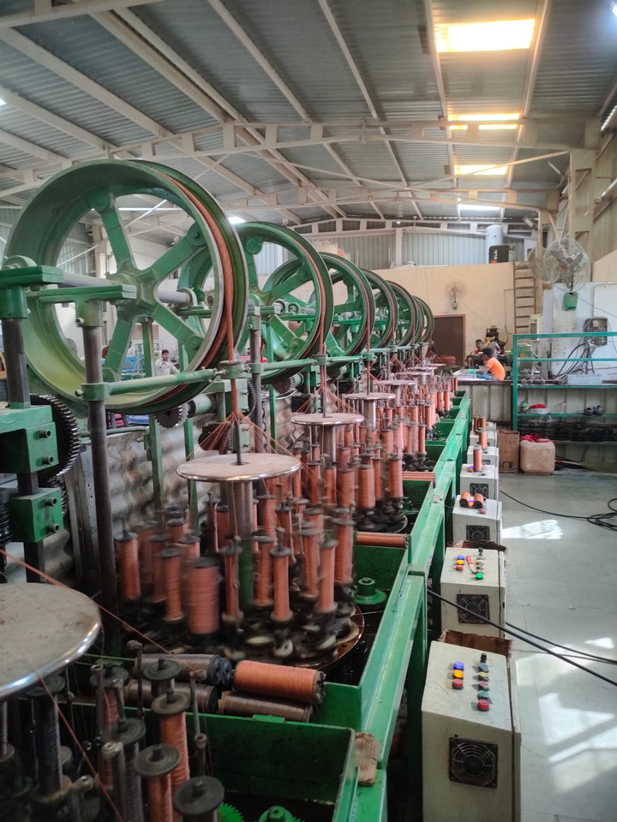
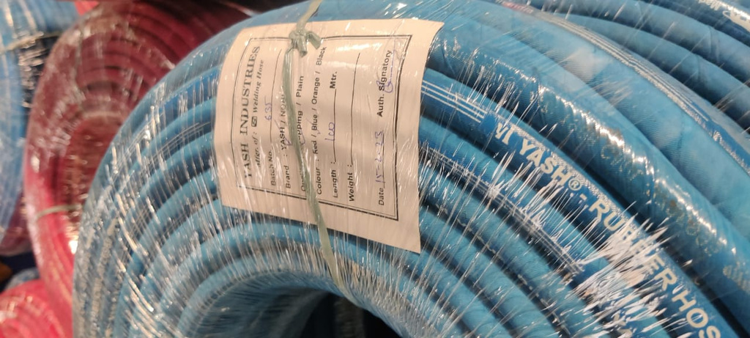
9

Slide 10
Barriers
Technical Errors
Building Design Error
Legal Barriers
Financial Issues
10

Slide 11
Enablers
Policy and Strategy
Leadership
Risk Management
Collaboration
Agile and flexible manufacturing
Quality Control
11
Source: Ref10

Slide 12
ISM methodology and model development
ISM structures related variables into a systemic model for interactive learning.
The ISM model uses graphics and words to portray complex issues in a carefully designed pattern.
ISM imposes order and direction on complex relationships among elements of a system.
ISM is a tool for understanding and addressing complex problems.
ISM provides a comprehensive systemic model of a problem, making it easier to analyze and address.
12
Source: Ref1

Slide 13
Steps involved
SSIM
Reachability Matrix
Level partitioning
ISM
13

Slide 14
Applying ISM on identified Barriers:
Let’s assume that
B1= Technical errors
B2= Errors in the design of facilities or building
B3= Legal and regulatory Barriers
B4= Financial Issues
Step1: SSIM
Element | B1 | B2 | B3 | B4
B1 | X | O | V | O
B2 |  | X | X | A
B3 |  |  | X | V
B4 |  |  |  | X
14

Slide 15
Step 2: Reachability matrix:
Element | B1 | B2 | B3 | B4
B1 | 1 | 0 | 1 | 0
B2 | 0 | 1 | 1 | 0
B3 | 0 | 1 | 1 | 1
B4 | 0 | 0 | 0 | 1
Element | B1 | B2 | B3 | B4 | Driving Power
B1 | 1 | 1* | 1 | 1* | 4
B2 | 0 | 1 | 1 | 1* | 3
B3 | 0 | 1 | 1 | 1 | 3
B4 | 0 | 0 | 0 | 1 | 1
Dependence | 1 | 3 | 3 | 4 | 11/11
15

Slide 16
Step 3: Level partitioning:
Iterations:
Element | Reachability set | Antecedent set | Intersection | Level
B1 | 1,2,3,4 | 1 | 1
B2 | 2,3,4 | 1,2,3 | 2,3
B3 | 2,3,4 | 1,2,3 | 2,3
B4 | 4 | 1,2,3,3,4 | 4 | Level1
Element | Reachability set | Antecedent set | Intersection | Level
B1 | 1,2,3 | 1 | 1
B2 | 2,3 | 1,2,3 | 2,3 | Level 2
B3 | 2,3 | 1,2,3 | 2,3 | Level 2
16

Slide 17
Element | Reachability set | Antecedent set | Intersection | Level
B1 | 1 | 1 | 1 | Level 3
17

Slide 18
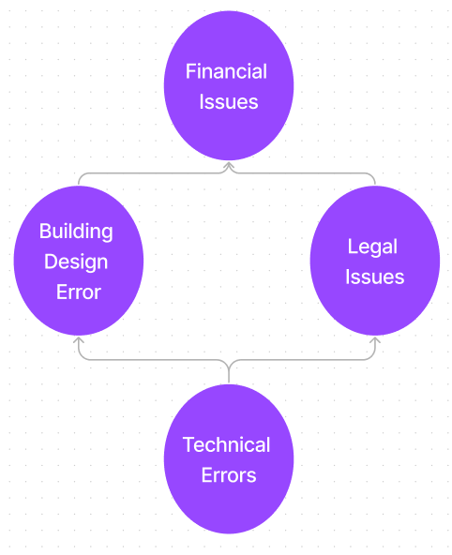
Step 4: Development of ISM
18

Slide 19
Applying ISM on identified Enablers:
Let’s assume that
E1= Leadership
E2= Policy and Strategy
E3= Risk Management
E4= Collaboration for Technology and Digitization
E5= Quality Control
E6= Agile and flexible manufacturing
Step1: SSIM
Element | E1 | E2 | E3 | E4 | E5 | E6
E1 | X | V | V | V | V | V
E2 |  | X | V | O | V | V
E3 |  |  | X | O | X | A
E4 |  |  |  | X | V | O
E5 |  |  |  |  | X | X
E6 |  |  |  |  |  | X
19

Slide 20
Step 2: Reachability matrix:
Element | E1 | E2 | E3 | E4 | E5 | E6
E1 | 1 | 1 | 1 | 1 | 1 | 1
E2 | 0 | 1 | 1 | 0 | 1 | 1
E3 | 0 | 0 | 1 | 0 | 1 | 0
E4 | 0 | 0 | 0 | 1 | 1 | 0
E5 | 0 | 0 | 1 | 0 | 1 | 1
E6 | 0 | 0 | 1 | 0 | 1 | 1
Element | E1 | E2 | E3 | E4 | E5 | E6 | Driving Power
E1 | 1 | 1 | 1 | 1 | 1 | 1 | 6
E2 | 0 | 1 | 1 | 0 | 1 | 1 | 4
E3 | 0 | 0 | 1 | 0 | 1 | 1* | 3
E4 | 0 | 0 | 1* | 1 | 1 | 1* | 4
E5 | 0 | 0 | 1 | 0 | 1 | 1 | 3
E6 | 0 | 0 | 1 | 0 | 1 | 1 | 3
Dependence | 1 | 2 | 6 | 2 | 6 | 6 | 23/23
20

Slide 21
Step 3: Level partitioning:
Iterations:
Element | Reachability set | Antecedent set | Intersection | Level
E1 | 1,2,3,4,5,6 | 1 | 1
E2 | 2,3,5,6 | 1,2 | 2
E3 | 3,5,6 | 1,2,3,5,6 | 3,5,6 | Level 1
E4 | 2,3,4,5,6 | 1,4 | 4
E5 | 3,5,6 | 1,2,3,4,5,6 | 3,5,6 | Level 1
E6 | 3,5,6 | 1,2,3,45,6 | 3,5,6 | Level1
21

Slide 22
Element | Reachability set | Antecedent set | Intersection | Level
E1 | 1,2,4 | 1 | 1
E2 | 2 | 1,2 | 2 | Level 2
E4 | 2,4 | 1,4 | 4
Element | Reachability set | Antecedent set | Intersection | Level
E1 | 1,4 | 1 | 1
E4 | 4 | 1,4 | 4 | Level 3
Element | Reachability set | Antecedent set | Intersection | Level
E1 | 1 | 1 | 1 | Level 4
22

Slide 23
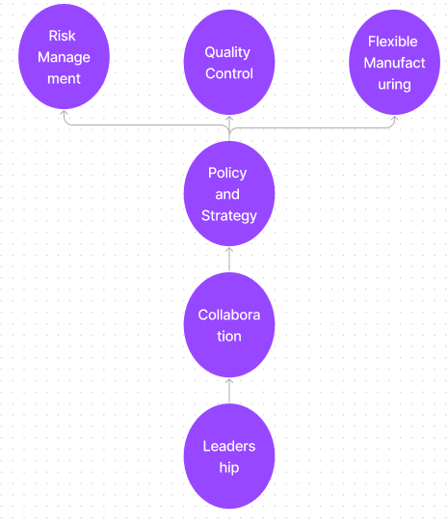
Step 4: Development of ISM
23

Slide 24
Future Work:
Identifying Industrial safety issues industry wise like casting industry, welding industry etc.
Learning and applying different model development methods like MIC MAC
24

Slide 25
Conclusion:
Safe worker environment is essential for both workers and management.
Industries need to apply ISM-like tools to identify the fundamental cause of any anticipated disaster.
24

Slide 26
Bibliography
1. Sharma, V., Dixit, A.R., Qadri, M.A. and Kumar, S., 2015. An interpretive hierarchical model for lean implementation in machine tool sector. International Journal of Productivity and Quality Management, 15(3), pp.381-406.
Vancouver
2. Botzen, W.W., Deschenes, O. and Sanders, M., 2019. The economic impacts of natural disasters: A review of models and empirical studies. Review of Environmental Economics and Policy.
3. Thomas, D. and Helgeson, J., 2021. The effect of natural/human-made hazards on business establishments and their supply chains. International Journal of Disaster Risk Reduction, 59, p.102257.
4. Munim, Z.H., Azmat, M. and Dorfer, B., 2015. Impact of man-made disasters on commercial logistics. Int J Econom Commerce Manage, 3(6), pp.128-138.
5. Hasan, F., Bellenstedt, M.F.R. and Islam, M.R., 2022. Demand and supply disruptions during the Covid-19 crisis on firm productivity. Global Journal of Flexible Systems Management, pp.1-19.
6. Curtis, S., 2015. Assessing Liaison Librarians: Documenting Impact for Positive Change. Eds. Daniel C. Mack and Gary W. White. Chicago, Ill.: Association of College and Research Libraries/A division of the American Library Association, 2014. 154p. $44.00 (ISBN 978-083898708-7). LC 2014041523. College & Research Libraries, 76(5), pp.708-710.
7. Jaeger, B. and Upadhyay, A., 2020. Understanding barriers to circular economy: cases from the manufacturing industry. Journal of Enterprise Information Management, 33(4), pp.729-745.
8. Kamdina, L., Simchenko, O., Grakhov, V., Suntsov, A. and Chazov, E., 2021. The impact of man-made accidents and catastrophes in the stable functioning of industrial enterprises on the quality of life of the population and socio-economic development. In E3S Web of Conferences (Vol. 296, p. 06004). EDP Sciences.
9. Brown, K.A., Willis, P.G. and Prussia, G.E., 2000. Predicting safe employee behavior in the steel industry: Development and test of a sociotechnical model. Journal of Operations management, 18(4), pp.445-465.
10. Chinda, T., 2012. A safety assessment approach using safety enablers and results. International journal of occupational safety and ergonomics, 18(3), pp.343-361.
11. Unnikrishnan, S., Iqbal, R., Singh, A. and Nimkar, I.M., 2015. Safety management practices in small and medium enterprises in India. Safety and health at work, 6(1), pp.46-55.
12. https://www.intechopen.com/chapters/73522
13. Berry, A., 2007, October. The importance of SMEs in the economy. In ITD Global Conference on Taxation of Small and Medium Enterprise.
14. Wu, T.C., Chen, C.H. and Li, C.C., 2008. A correlation among safety leadership, safety climate and safety performance. Journal of loss prevention in the process industries, 21(3), pp.307-318.
15. https://www.mfasco.com/blog/safety-topics/7-reasons-why-workplace-safety-is-so-important.html
25

Slide 27
Thank you
for listening!
26

